Slide 1
ICES-Tech Prava
Datathon for begineers

Slide 2
DIFFERENT CHARTS IN RELATION TO THE VOTES RECEIVED BY EACH CANDIDATE IS:
CENTRAL ELECTION 2079 RESULT ANALYSIS FROM KASKI, LAMJUNG,SYANGJYA,BAGLUNG,

Slide 3
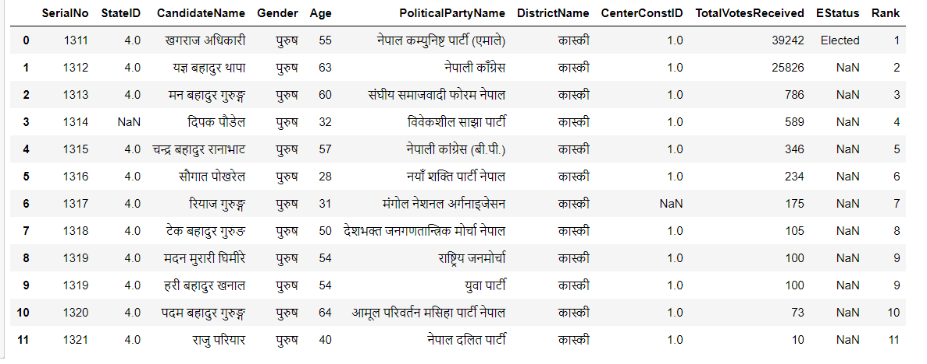
KASKI UNCLEANED DATA FROM AREA 1:

Slide 4
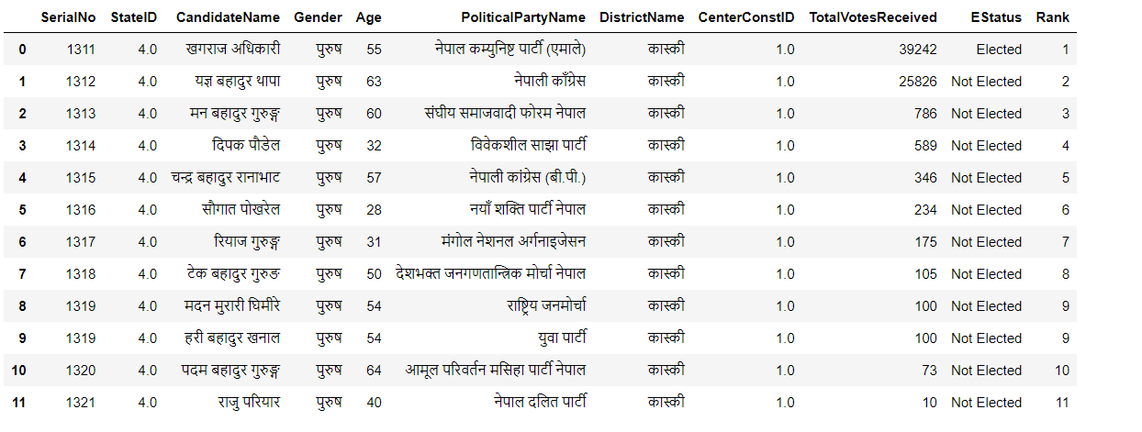
KASKI DATA FROM AREA 1:

Slide 5
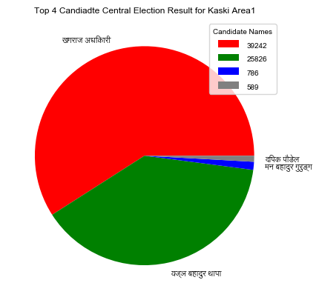

Slide 6
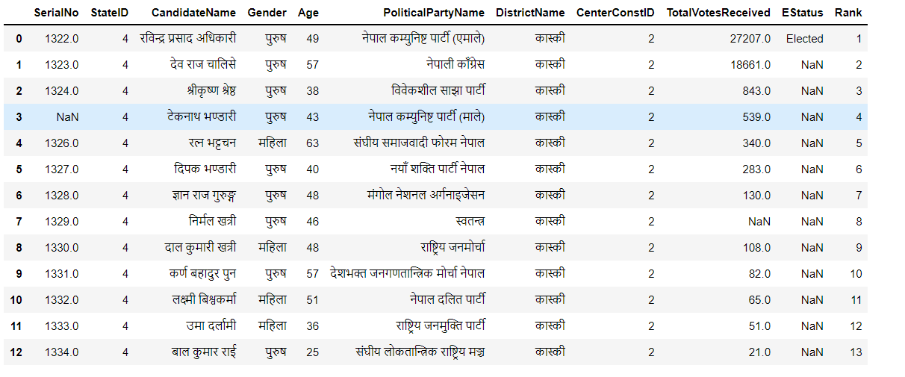
KASKI UNCLEANED DATA FROM AREA 2:

Slide 7
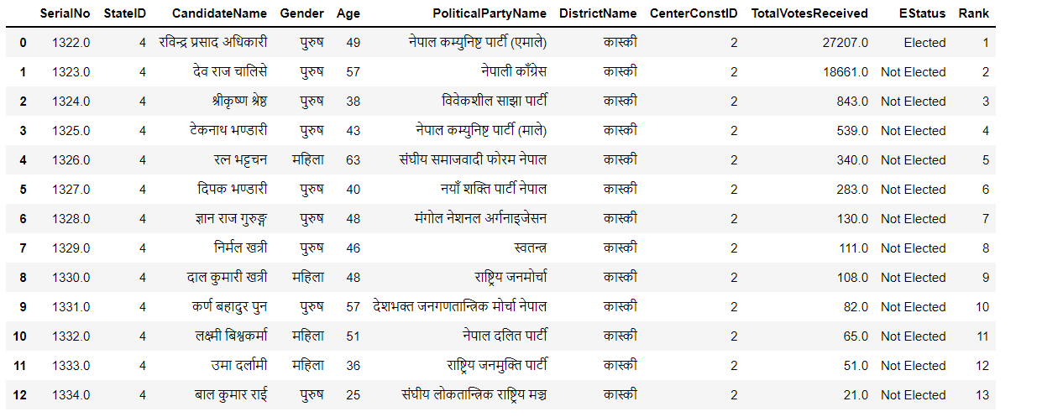
KASKI DATA FROM AREA 2:

Slide 8
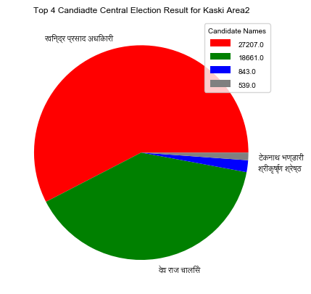

Slide 9
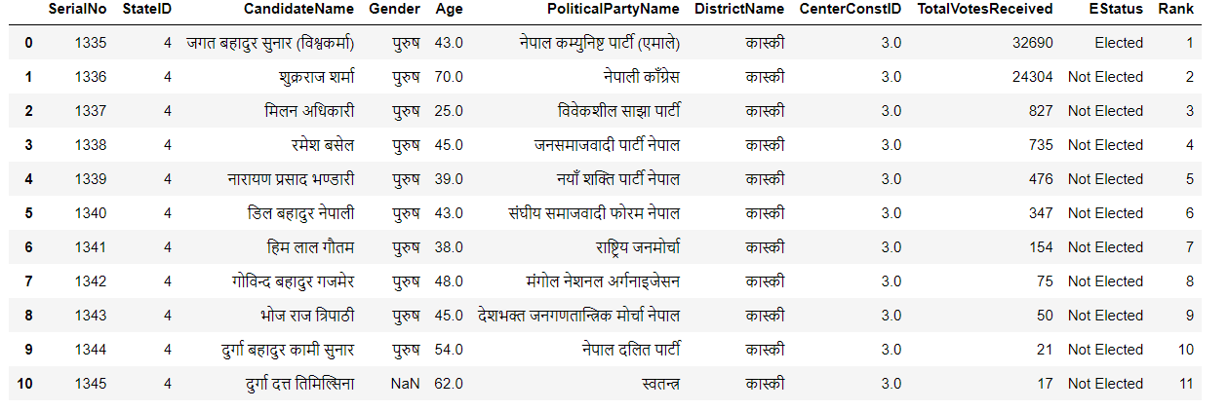
KASKI DATA FROM AREA 3:

Slide 10
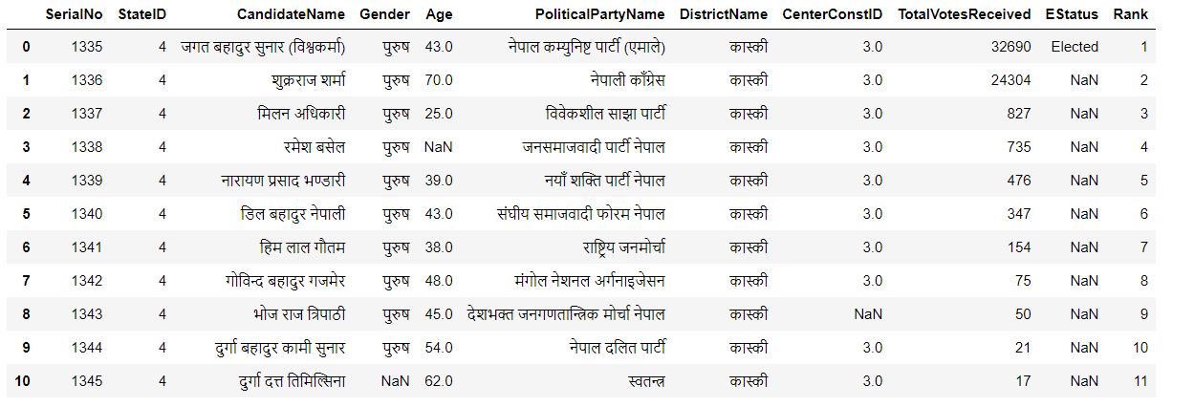
KASKI UNCLEANED DATA FROM AREA 3:

Slide 11


Slide 12
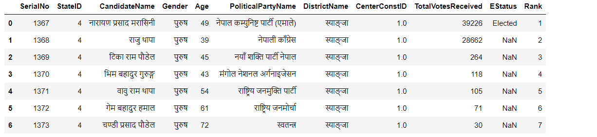
SYANGJYA UNCLEANED DATA FROM AREA 1:

Slide 13
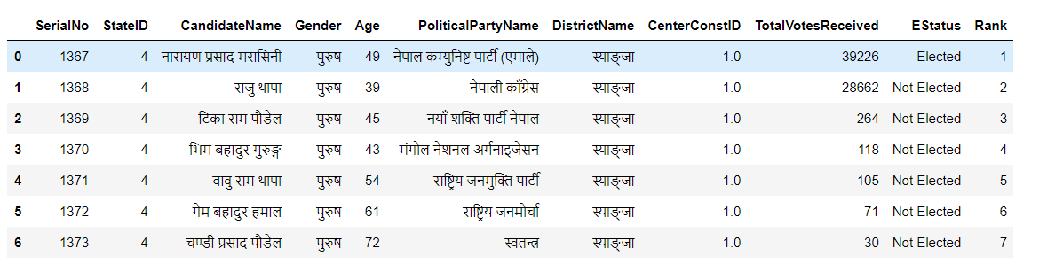
SYANGJYA DATA FROM AREA 1:

Slide 14
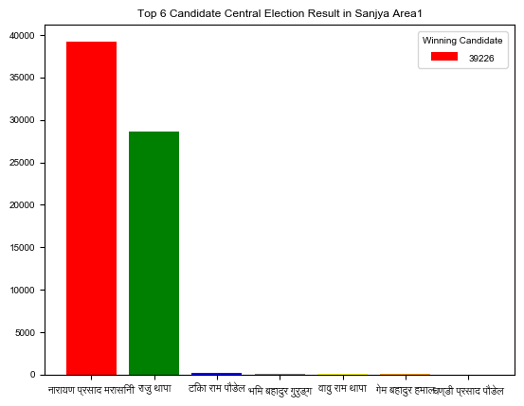

Slide 15
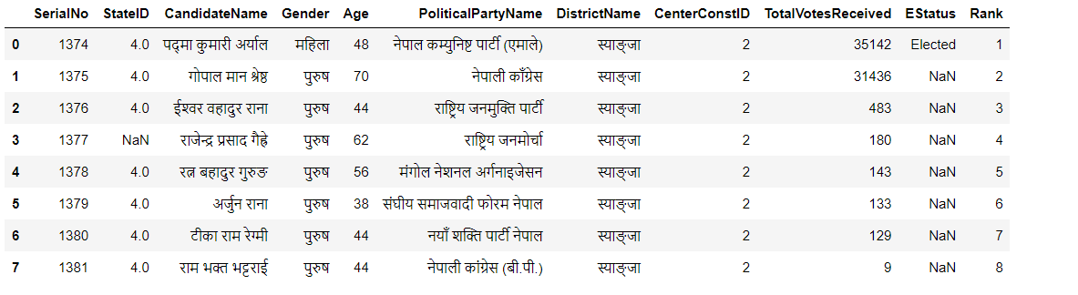
SYANGJYA UNCLEANED DATA FROM AREA 2:

Slide 16
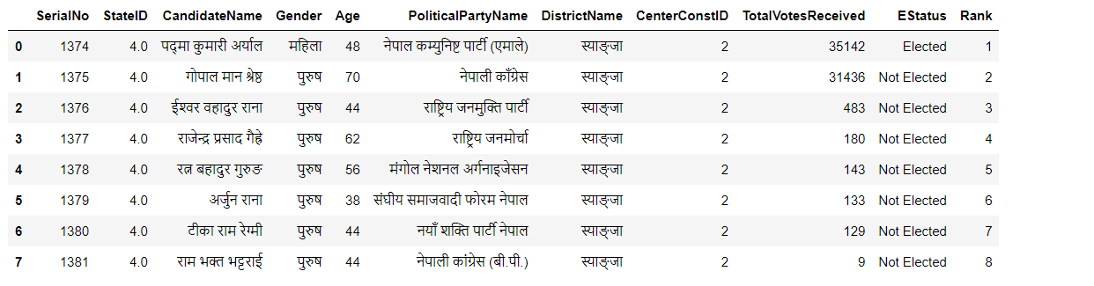
SYANGJYA DATA FROM AREA 2:

Slide 17
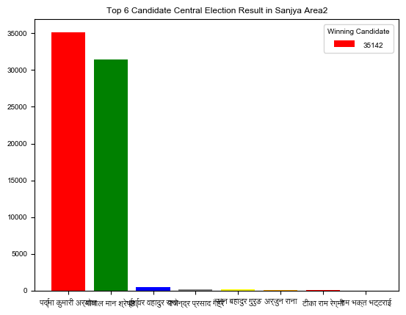

Slide 18
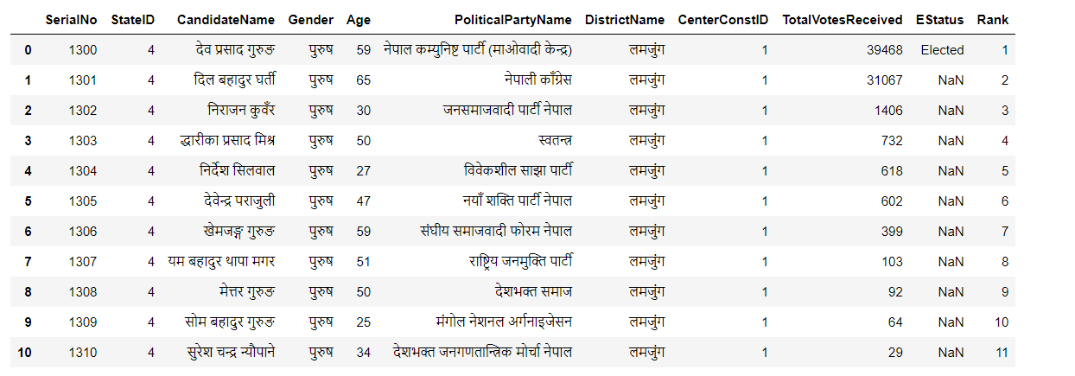
LAMJUNG UNCLEANED DATA FROM AREA 1:

Slide 19
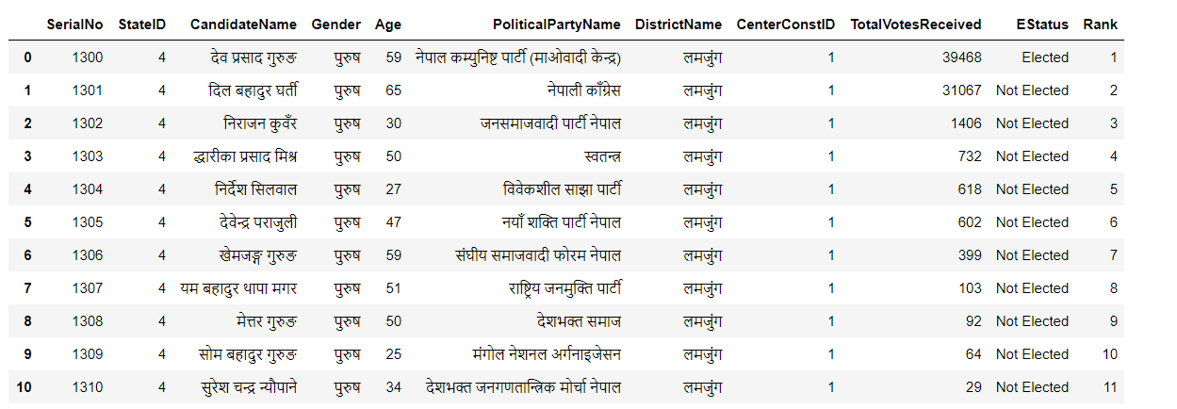
LAMJUNG DATA FROM AREA 1:

Slide 20
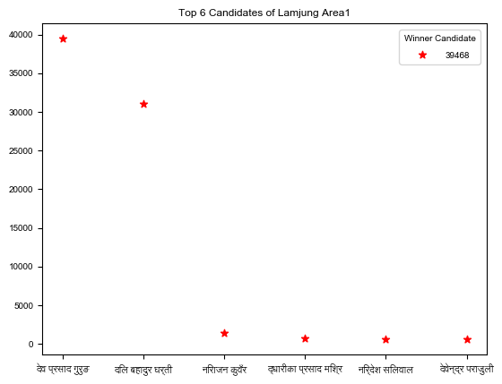

Slide 21
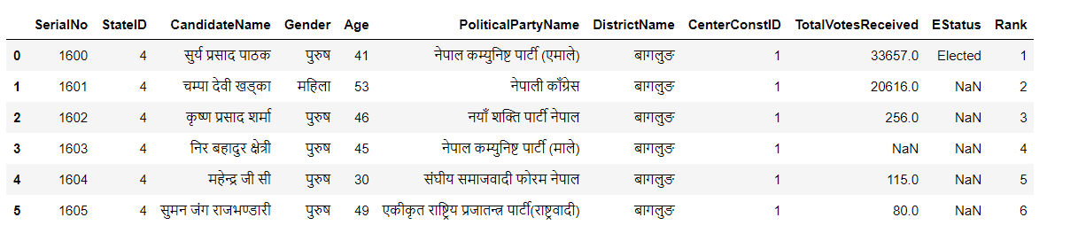
BAGLUNG UNCLEANED DATA FROM AREA 1:

Slide 22
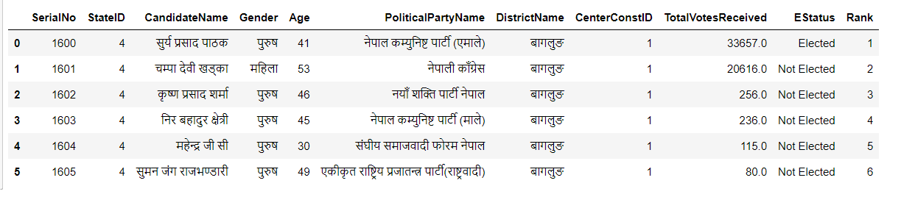
BAGLUNG DATA FROM AREA 1:

Slide 23
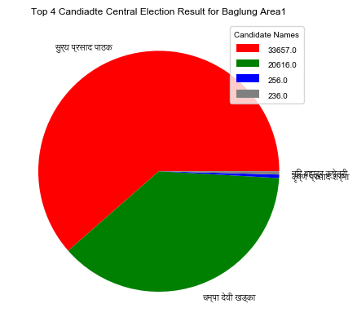

Slide 24
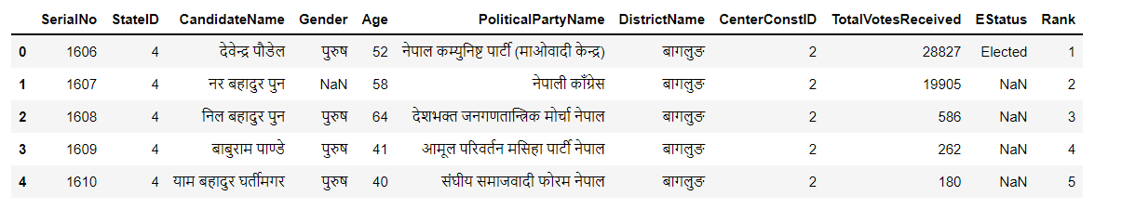
BAGLUNG UNCLEANED DATA FROM AREA 2:

Slide 25
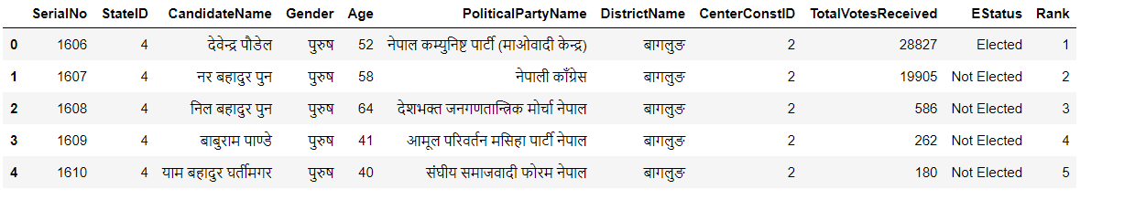
BAGLUNG DATA FROM AREA 2:

Slide 26
